Slide 1

Introduction to Reactjs
By Joey Chua

Slide 2
About Me
Joey
Data Scientist @ Vertex
https://www.linkedin.com/in/joeychuasm/

Slide 3
About Me
Overview of React
Joey
Data Scientist @ Vertex
What is React
Why React
Using React
Create a simple app

Slide 4
Overview of React
What is React
Why React
Using React
Create a simple app
Why React?

Slide 5
It is easy to understand, has a large community, and is one of the most popular library

Slide 6
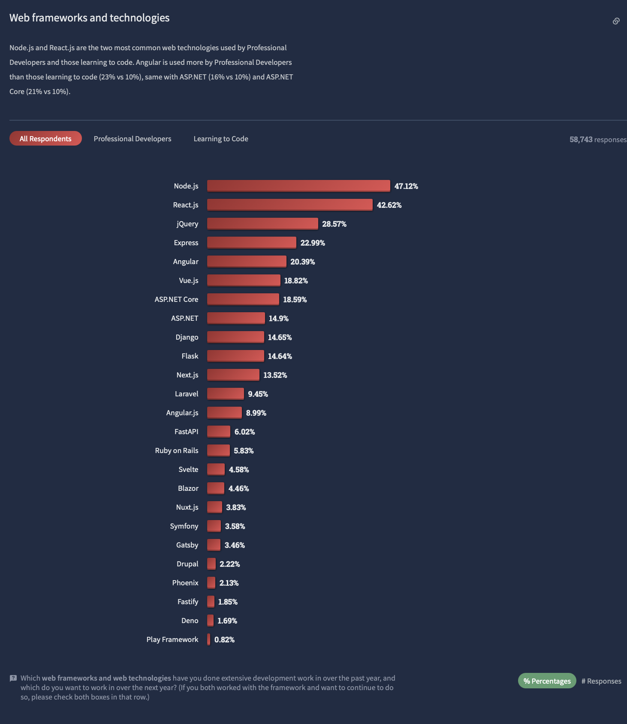
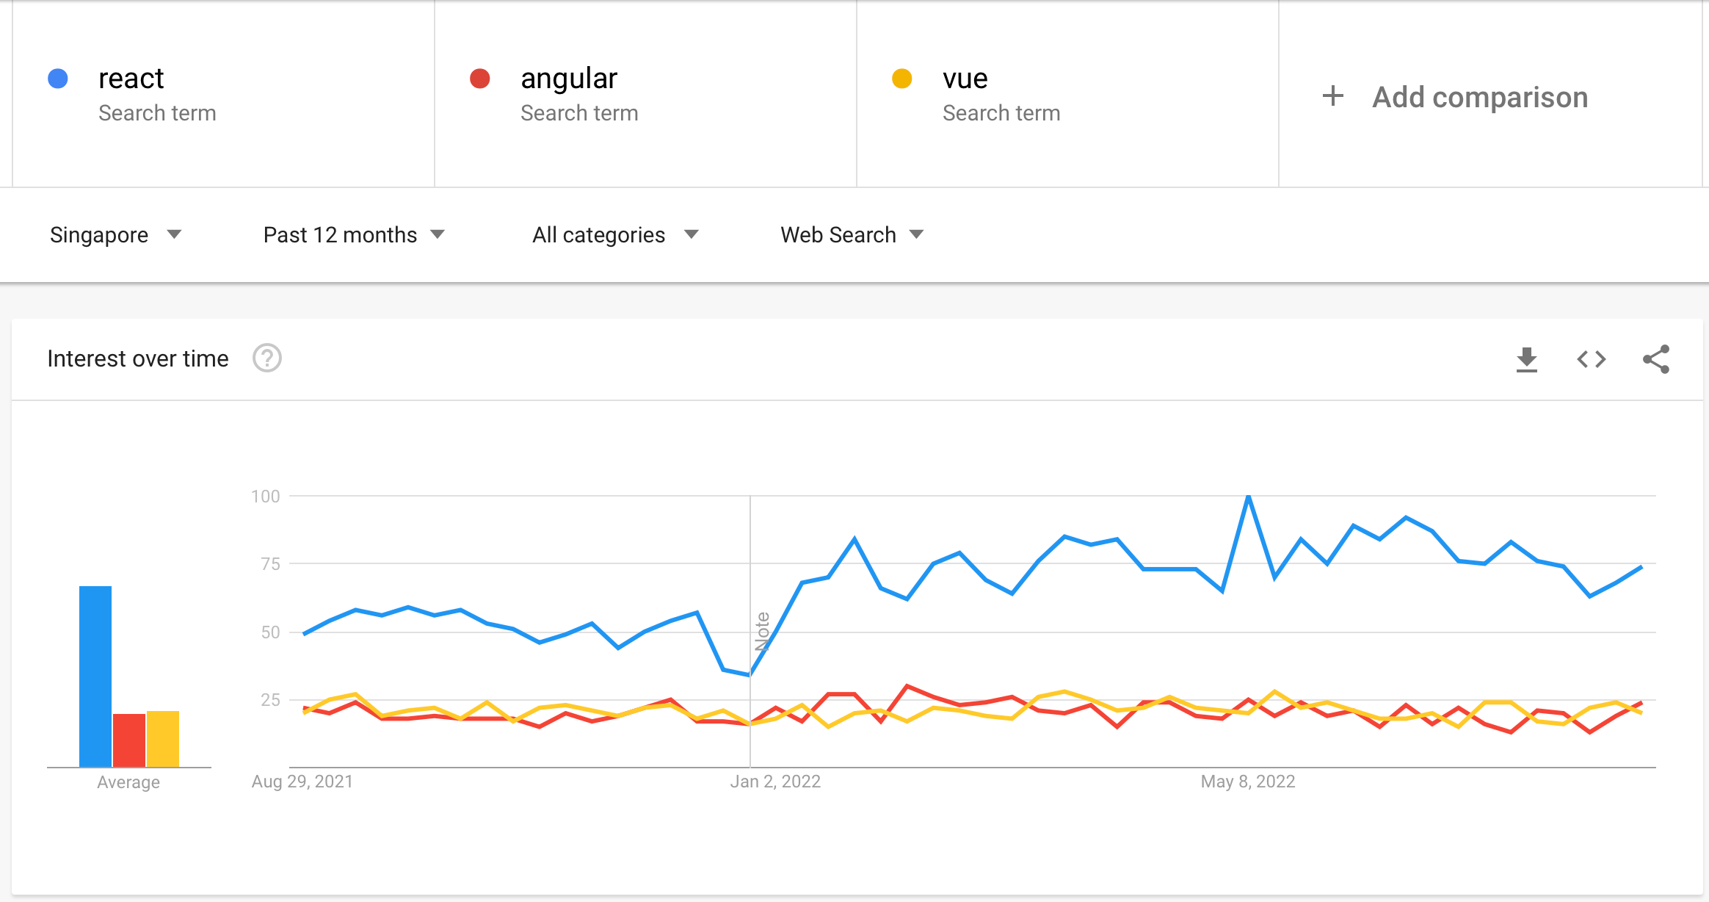
Trends

Slide 7




Stack
M
E
R
N

Slide 8
What is React?

Slide 9
React is a JavaScript library for building user interfaces

Slide 10
Declarative
Each line of code declares what each element of the app is.

Slide 11
Component-based
Build reusable UI elements and Javascript functions that accepts inputs

Slide 12
Header Component
Content Component
Sidebar
Component
Content Component
Content Component

Slide 13
Two Types of Components
1. Class-based
2. Functional

Slide 14
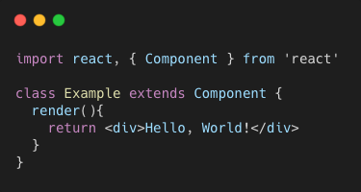
Class-based

Slide 15
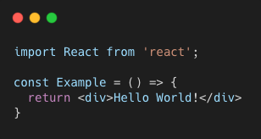
Functional

Slide 16
How to use React?

Slide 17
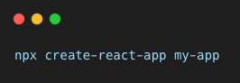
React Environment Setup
Manually set up using webpack & babel
Use create-react-app command

Slide 18
Create-react-app is a simple tool or command that generates required files & folders to start the application

Slide 19

Node is a Javascript runtime that allows us to execute JS code on the server

Slide 20
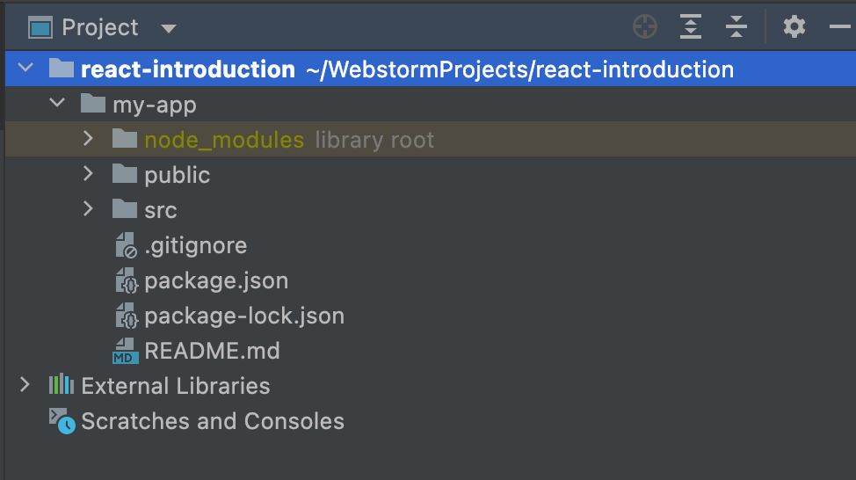
Files and Folders
node_modules: Source code for dependencies. Do not touch.
Public: The directory where your static files are stored
src
public
package.json: the main file that defines the dependencies and other settings for the project

Slide 21
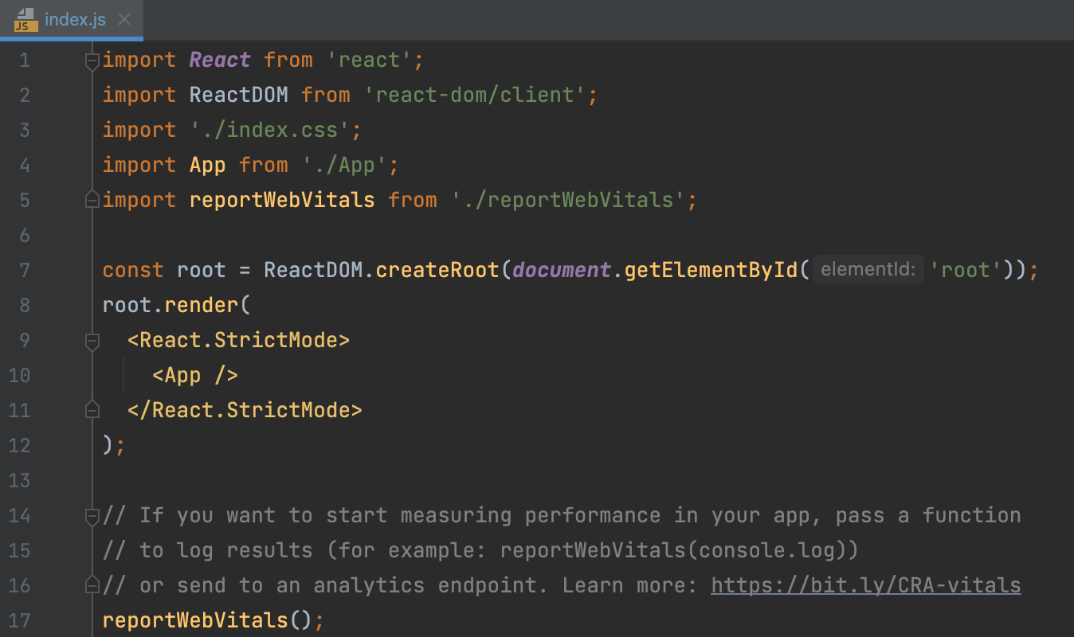
Index.js
We have react DOM to render the application with ID root.

Slide 22
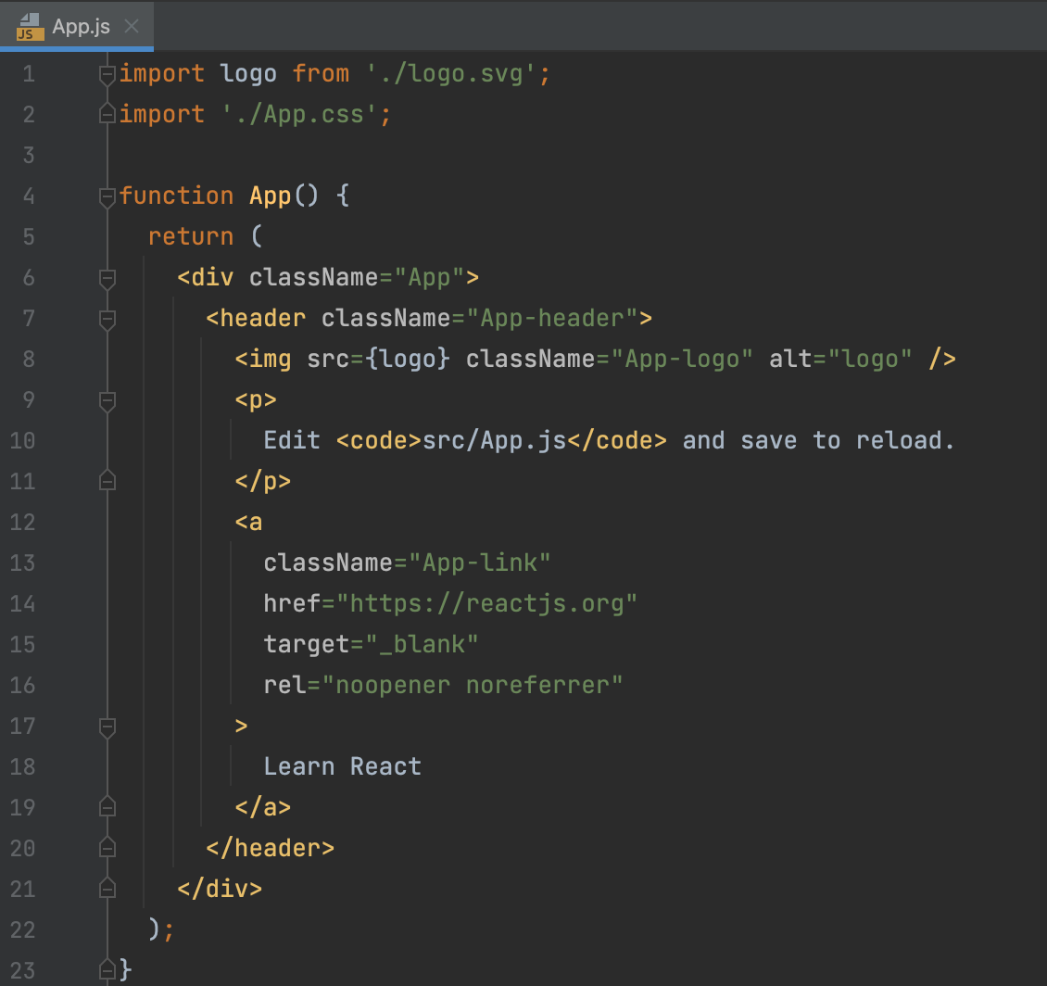
App.js
In HTML, we write class but in JSX we will write className

Slide 23
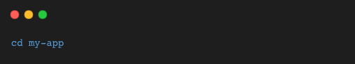
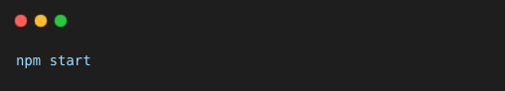
Terminal
Change Directory
Start

Slide 24
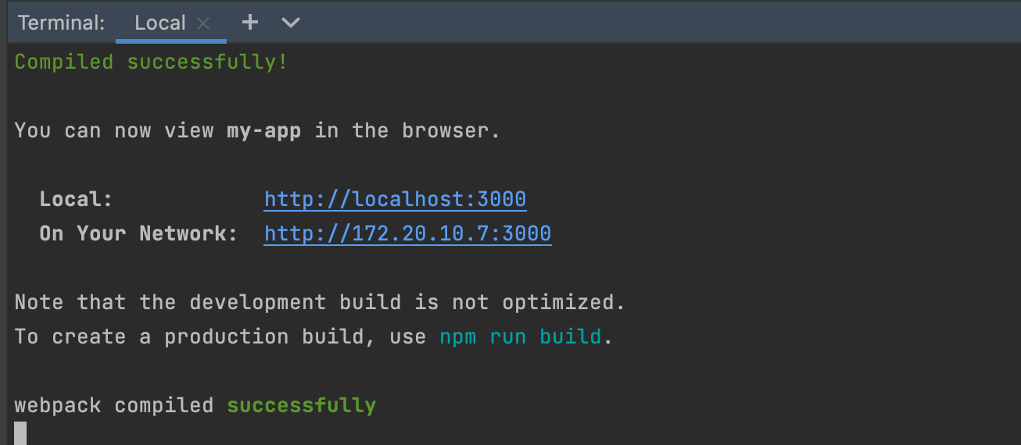
Terminal

Slide 25
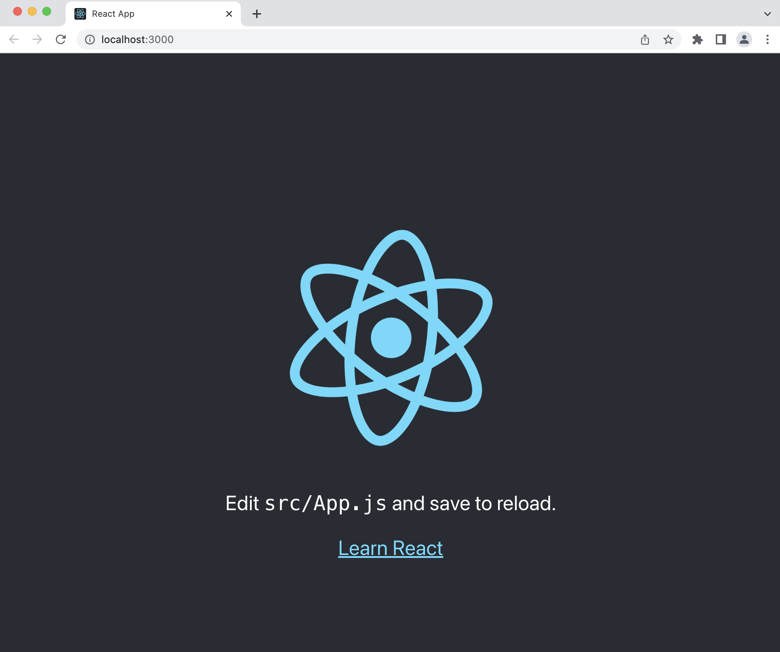
LocalHost

Slide 26
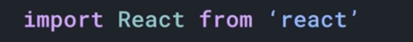
App.js
To use the library, we need to import React

Slide 27
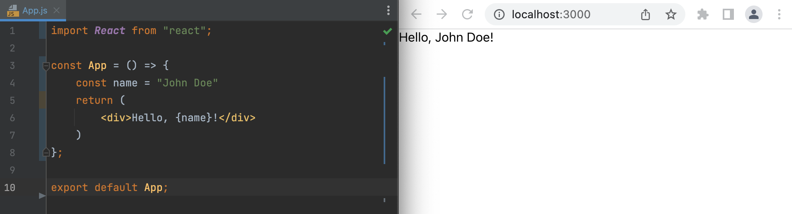
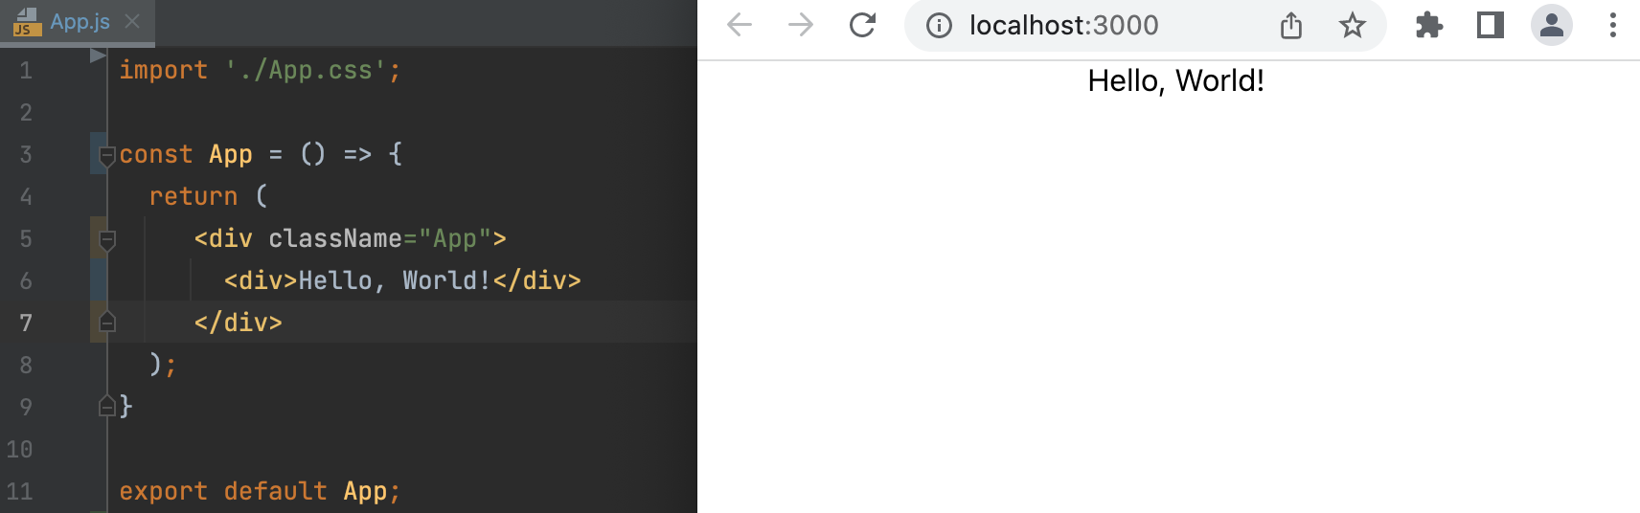
App.js
App.js
Delete function and change to const
Delete function and change to const

Slide 28
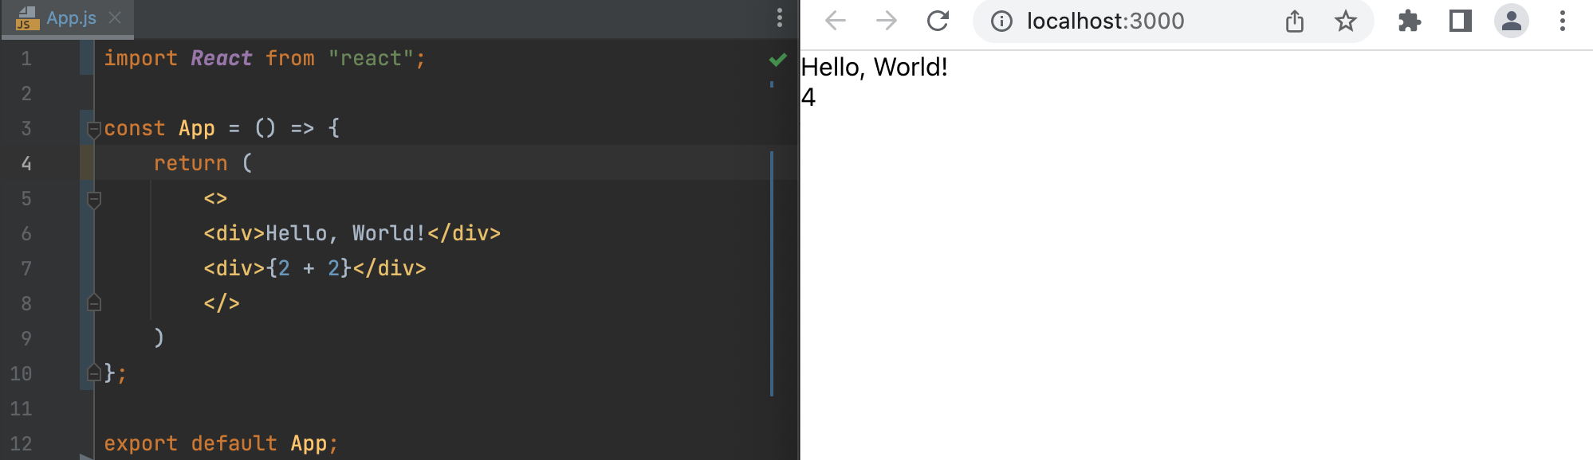
App.js
In the curly braces, we will put values inside
JSX is used to describe how the interface should look like

Slide 29
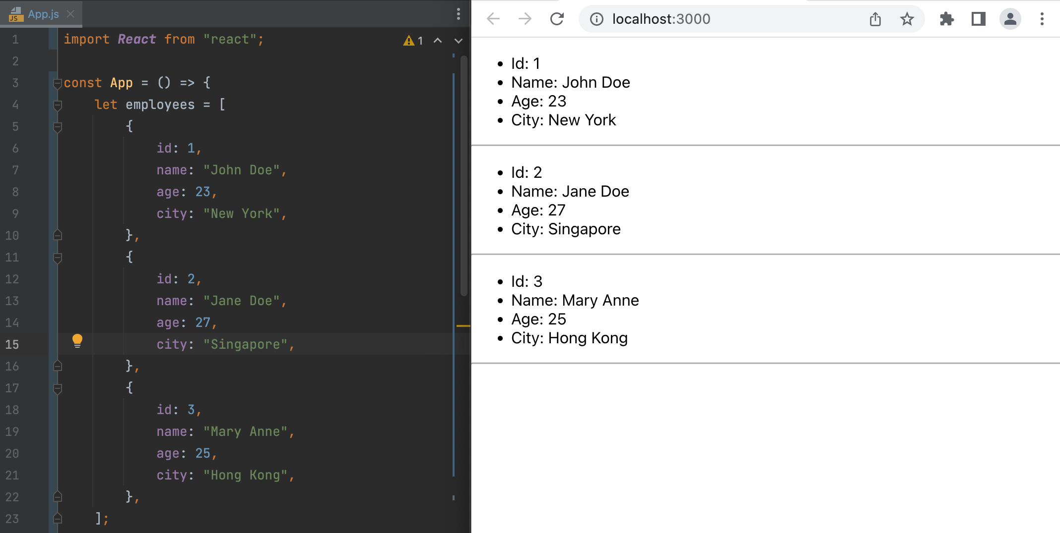
App.js
List and Keys

Slide 30
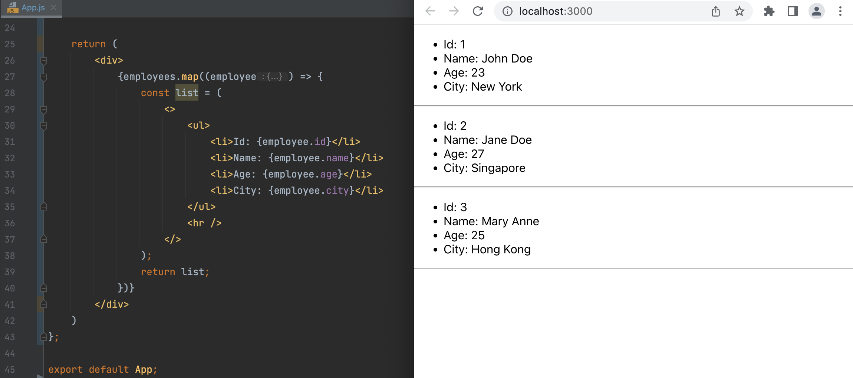
App.js
List and Keys

Slide 31

Hands-on
https://pokeapi.co

Slide 32
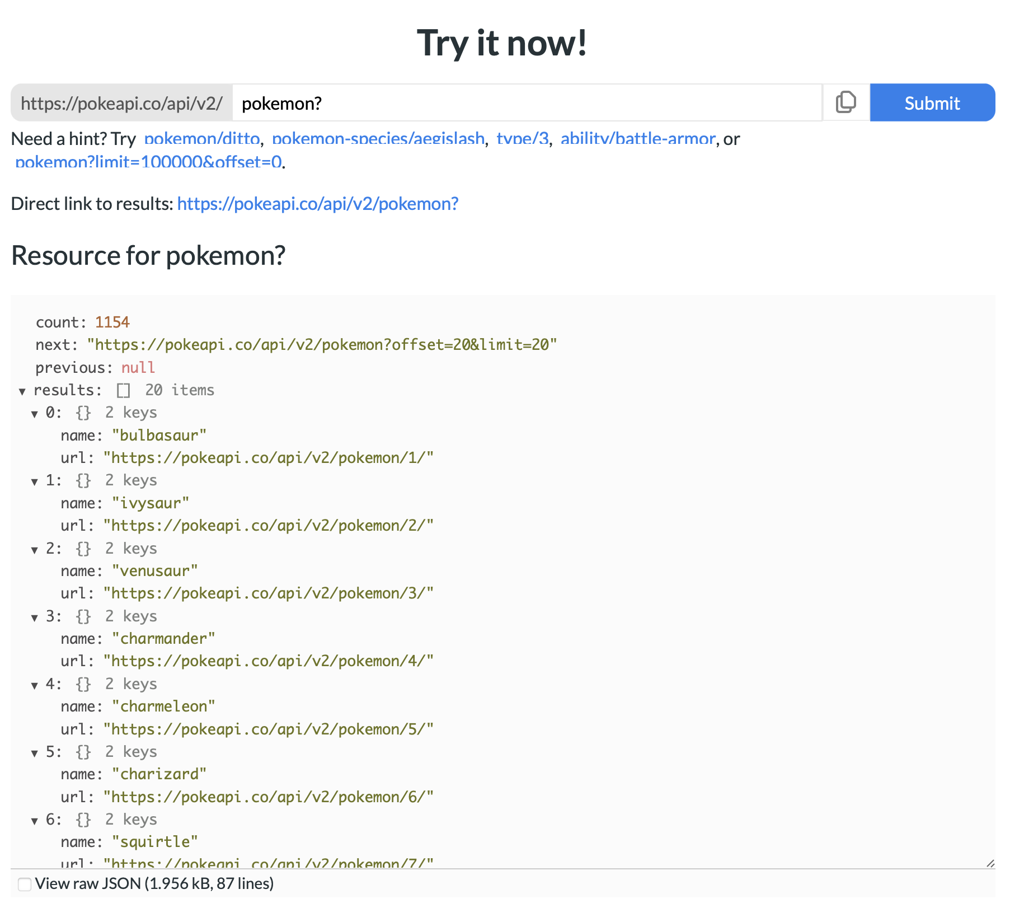
API

Slide 33
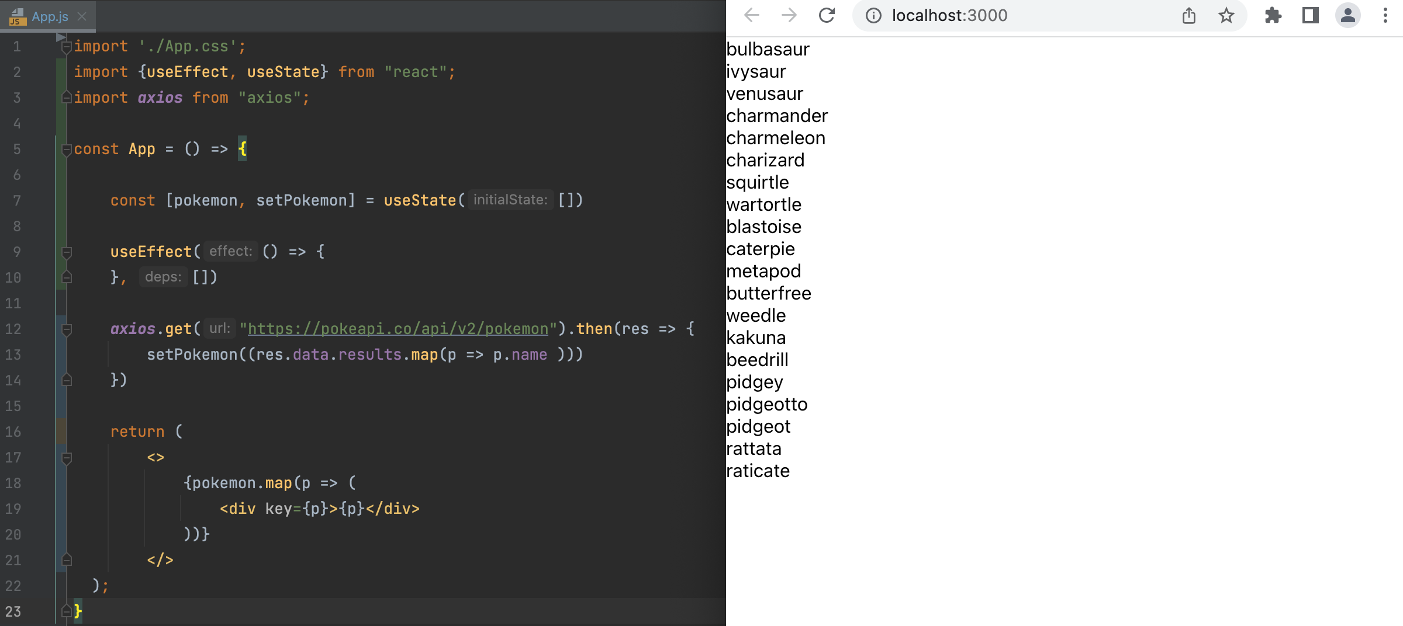
App.js
Axios, useEffect, useState, map

Slide 34
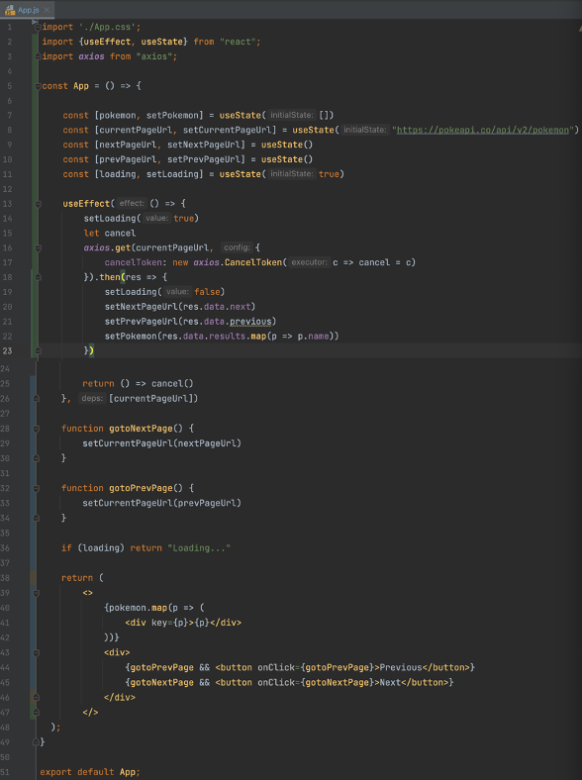
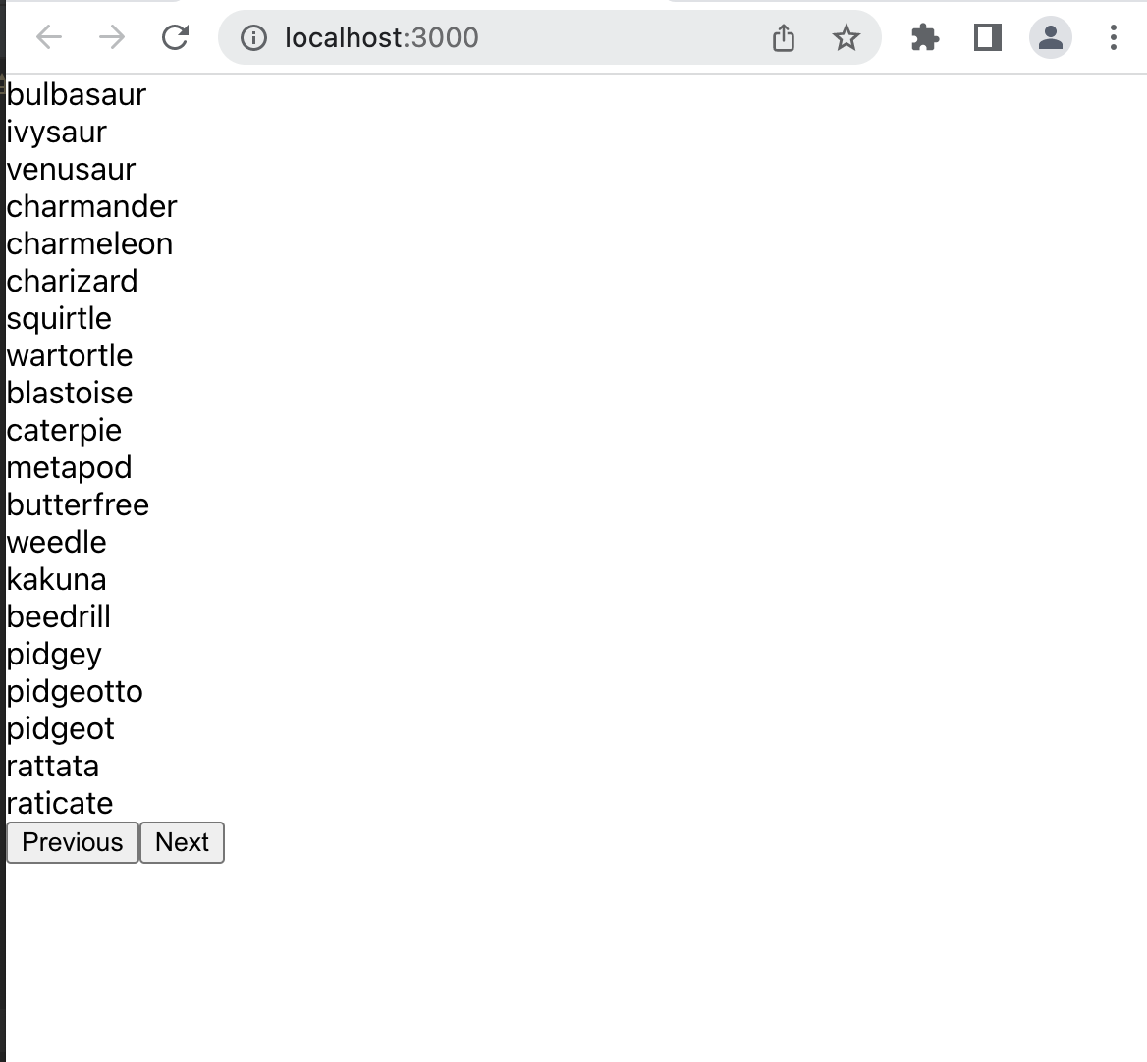
App.js
Pagination

